Slide 1
Page 1
CSE445
SECTION: 03
Super Resulation
Model
PRESENTED BY
Md. Misbah Khan | ID: 2132089642
Md Abdula Al Shyed | ID: 2212592042
Rakibul Islam | ID: 2212058642
Raju Ahamed Rabby | ID: 2212592042
NORTH SOUTH UNIVERSITY
24 FEBRUARY, 2025

Slide 2

Page 2
Significance
We can use this model to enhance low quality image.
To some extent, we can use this model to enhance video footage like CCTV footage.
NORTH SOUTH UNIVERSITY
24 FEBRUARY, 2025

Slide 3

Page 3
Dataset
We collect 100 High-Quality Image From pexels By Using their API
Then we under-sample those pictures then save it into the dataset
NORTH SOUTH UNIVERSITY
24 FEBRUARY, 2025

Slide 4
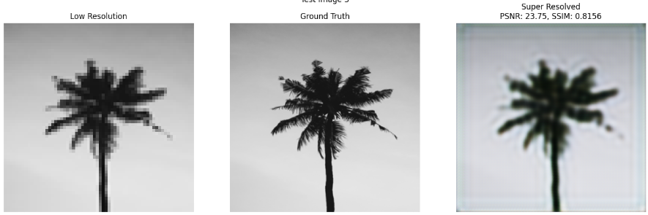
Page 4
CNN
Why I Chose This Model:
To enhance image quality by improving the resolution of low-quality images.
To leverage advancements in deep learning for better image reconstruction.
Problems:
The model requires high computational resources for training and inference.
Our dataset is too small, only 100 images
NORTH SOUTH UNIVERSITY
24 FEBRUARY, 2025

Slide 5
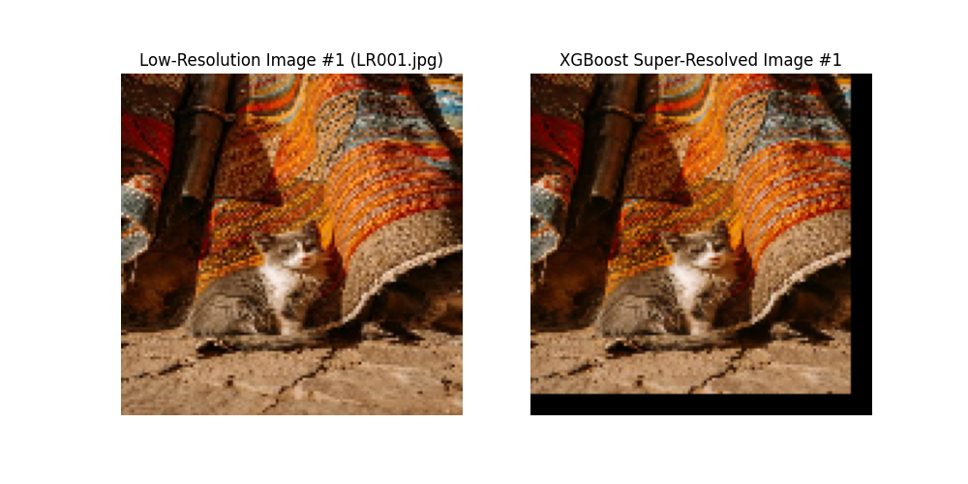
Page 5
XGBoost
Why I Chose This Model:
XGBoost is fast, efficient, and works well with GPU.
It captures non-linear relationships between low and high-resolution image patches.
Problems:
High memory usage with large patches.
Risk of overfitting with limited data (100 images).
NORTH SOUTH UNIVERSITY
24 FEBRUARY, 2025

Slide 6
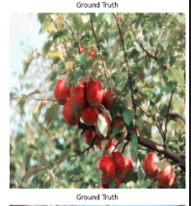
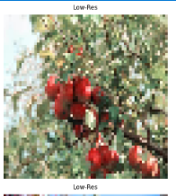
Page 6
SRGAN
Why I Chose This Model:
High-Quality Generation: Enhances images with fine details.
GAN Framework: Uses generator and discriminator for realism.
Problems:
High Computational Cost
Long Training Time
Dependence on Data Quality
NORTH SOUTH UNIVERSITY
24 FEBRUARY, 2025

Slide 7
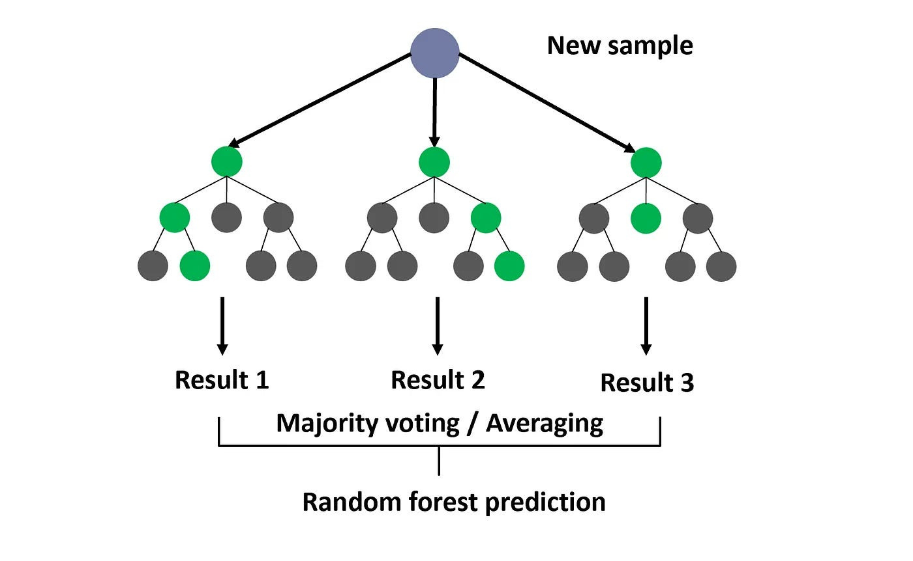

Page 7
Random Forest
WHY I CHOOSE THIS MODEL
COMPUTATIONALLY EFFICIENT FOR SMALLER TASKS.
EASY TO INTERPRET MODEL PREDICTIONS.
PROBLEM OF THIS MODEL
T
LESS EFFECTIVE FOR HIGH-QUALITY IMAGE SUPER-RESOLUTION.
TAKES SO MUCH TIME
NORTH SOUTH UNIVERSITY
24 FEBRUARY, 2025

Slide 8
Page 8
Future work
Model Accuracy Improve
Dealing with external smoke and ensuring real-time responsiveness.
NORTH SOUTH UNIVERSITY
24 FEBRUARY, 2025

Slide 9
Page 9
Conclusions
This project leveraged machine learning to enhance image resolution and deep learning for upscaling, effectively reducing artifacts. Evaluation metrics such as PSNR and SSIM demonstrated substantial improvements.
NORTH SOUTH UNIVERSITY
24 FEBRUARY, 2025

Slide 10
Page 10
Thank You
NORTH SOUTH UNIVERSITY
24 FEBRUARY, 2025

